Slide 1

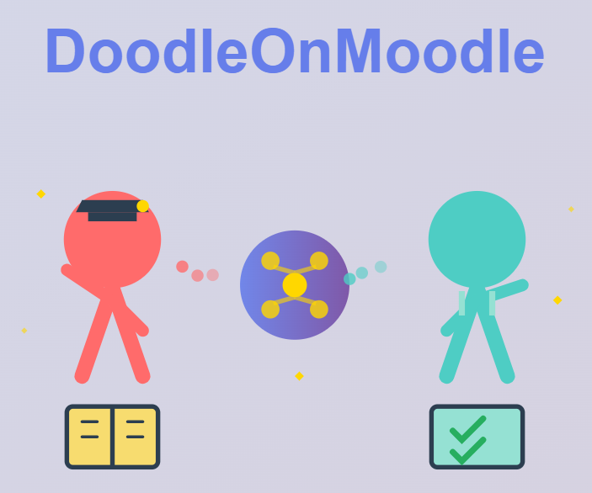
DoodleOnMoodle
AI-Powered Adaptive Learning System
Mayank A, Sakshi C
Team ZeroDowntime
October 10, 2025

Slide 2




Project Requirements: Defining Adaptive Learning
Instructor Login & Tools
Student Login & Quizzing
Ability for instructors to upload course material and create customized quizzes within the Moodle environment.
Students must be able to securely log in and take the assigned adaptive quizzes.
Adaptive Assessment Logic
Remediation & Progression
System must provide an analysis of the quiz results to the students. For correct answers, system must provide a quiz of higher difficulty.
Provide summaries for wrong answers and offer another quiz on missed concepts for personalized learning.

Slide 3

Software Design: Dual-Role Architecture
Instructor uploads material
System provides Course structure
Instructor chooses topics and subtopics
Student takes quizzes
Adaptive Quiz Engine
System generates quiz on the selected topics
System generates results for Student to view
Student gives correct answer
Student gives wrong answer
System challenges student with a harder question
System provides student with another question of same difficulty level
The system utilizes a dual-role architecture integrated directly into the Moodle platform, ensuring seamless content management and personalized student interaction.

Slide 4

Implementation & Technical Details
Moodle Plugin API
Developed as a custom Moodle plugin for core integration.
Database Schema
Custom tables to store quiz states and student performance metrics.
Adaptive Logic
Node/JavaScript logic handles real-time quiz generation and difficulty scaling.
AI Integration
External API calls for generating short summaries on missed concepts.

Slide 5




Current Status
100%
75%
Course Upload , Syllabus Generation and Quiz
Creation by Instructor
Adaptive Learning Engine
0%
25%
User Feedback
Moodle Integration
Initial alpha testing with a small group of students and one instructor underway.

Slide 6





Project Timeline: Key Milestones
Phase 1: Design & Setup
Phase 2: AI Integration
Completed : Implemented dual-role interfaces and basic
adaptive logic and core database structure.
Completed : Finalizing AI agent integration for course
generation personalized feedback.
Phase 4: Beta Launch
Phase 3: Core Development
Future: Comprehensive testing and full deployment across pilot courses.
Future: Moodle integration and SSO authentication.

Slide 7

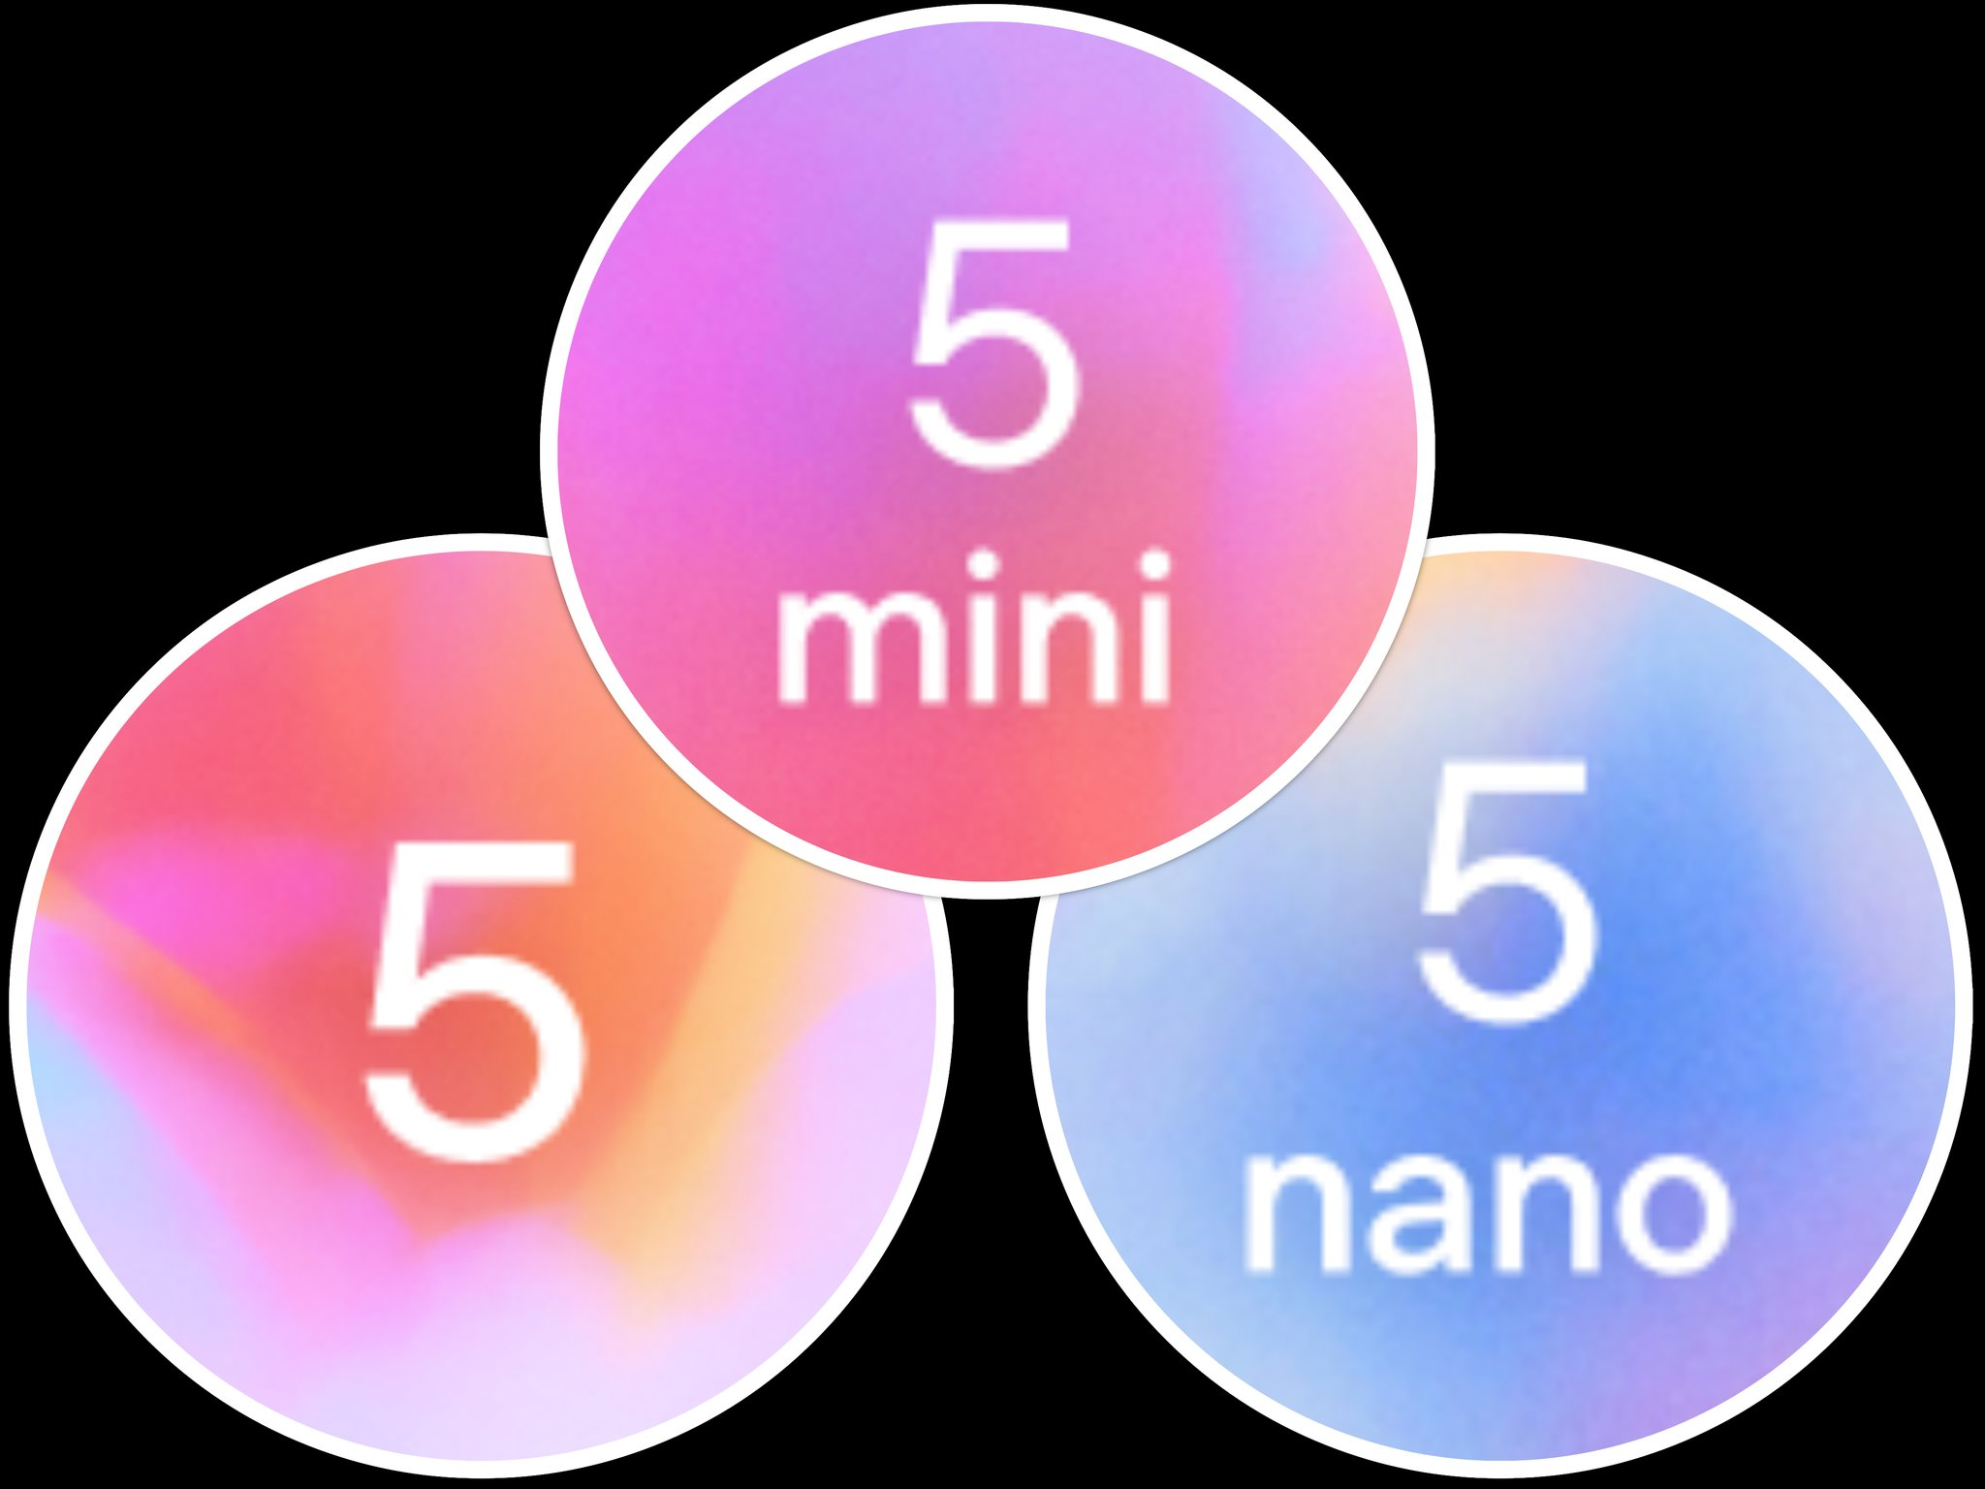
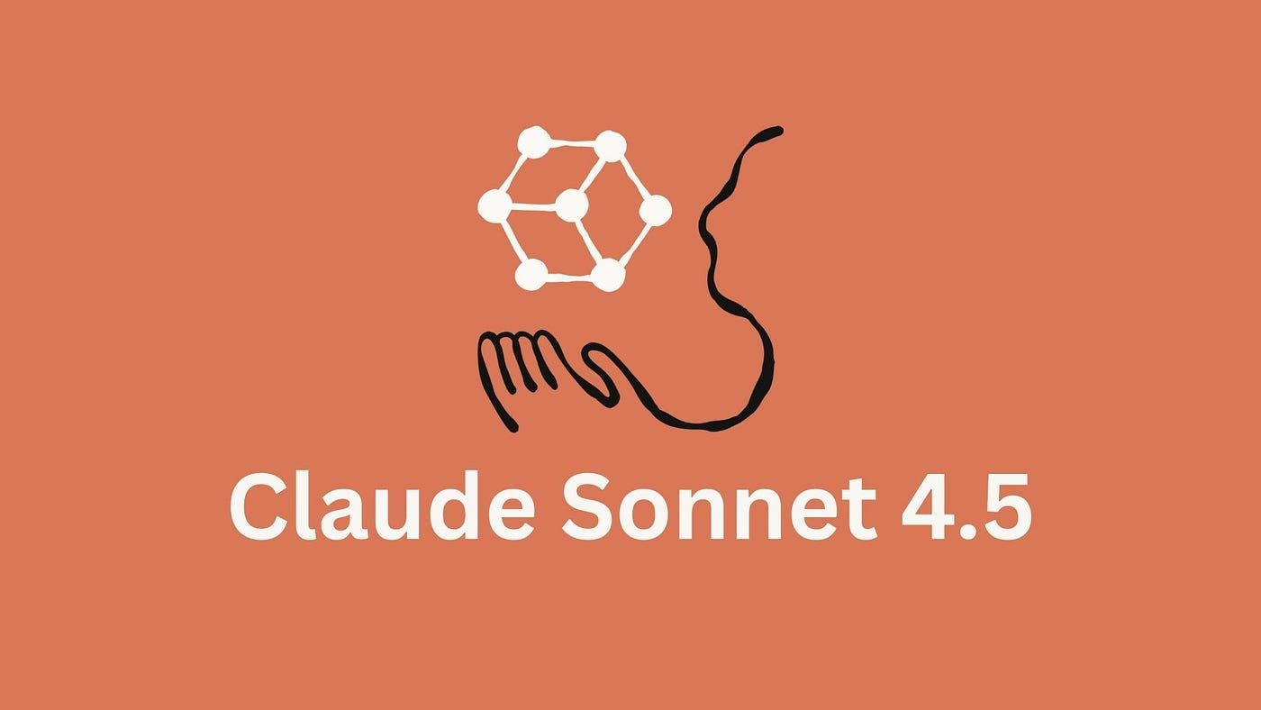

AI Agents Used
GPT5 Nano (primary)
Claude Sonnet 3.5
Claude Sonnet 4.5
ChatGPT
Adaptive Difficulty Agent
Remediation Summary Agent
This agent monitors student performance (correct/wrong answers) to determine the next quiz's difficulty level. It ensures continuous challenge without overwhelming the student.
When a student answers incorrectly, this agent generates a concise, short summary of the missed concept. This provides immediate, targeted feedback and a chance to retake the concept quiz.
Increases difficulty on correct answers.
Generates summaries from course material.
Maintains or decreases difficulty on incorrect answers.
Offers targeted retake options.

Slide 8




Adaptive Logic: The Student Journey
Start Quiz
Correct Answer
Student begins the initial assessment.
System serves a harder quiz on the next concept.
Wrong Answer
Remediation Loop
System provides a short summary of the missed concept.
Option to retake a targeted quiz before moving on.

Slide 9
Challenges Faced and Mitigation
Moodle Integration Complexity
AI Summary Quality
Performance Scaling
Challenge: Generating accurate, concise, and context-aware summaries for remediation.
Mitigation: Fine-tuning AI prompts and implementing human review of generated content during the alpha phase.
Challenge: Maintaining fast response times as the number of students and data points grows. Mitigation: Optimizing database queries and utilizing caching mechanisms for quiz generation.
Challenge: Ensuring seamless compatibility with various Moodle versions and existing plugins. Mitigation: Strict adherence to Moodle's official Plugin API and extensive unit testing.

Slide 10



DoodleOnMoodle: The Future of Learning
DoodleOnMoodle transforms traditional course management into a dynamic, personalized learning experience, ensuring every student receives the support and challenge they need to succeed.

